Slide 1


Slide 2
The Bias/Variance Trade-off in Machine Learning

Slide 3
Whenever we discuss model prediction, it’s important to understand prediction errors (bias and variance).
There is a tradeoff between a model’s ability to minimize bias and variance.
Gaining a proper understanding of these errors would help us not only to build accurate models but also to avoid the mistake of overfitting and underfitting.

Slide 4
What is bias?
Bias is the difference between the average prediction of our model and the correct value which we are trying to predict.
Model with high bias pays very little attention to the training data and oversimplifies the model.
It always leads to high error on training and test data.

Slide 5
What is variance?
Variance is the variability of model prediction for a given data point or a value which tells us spread of our data.
Model with high variance pays a lot of attention to training data and does not generalize on the data which it hasn’t seen before.
As a result, such models perform very well on training data but have high error rates on test data.

Slide 6
Underfitting
In supervised learning, underfitting happens when a model unable to capture the underlying pattern of the data.
These models usually have high bias and low variance.
It happens when we have very less amount of data to build an accurate model or when we try to build a linear model with a nonlinear data.
Also, these kind of models are very simple to capture the complex patterns in data like Linear and logistic regression.

Slide 7
Overfitting
In supervised learning, overfitting happens when our model captures the noise along with the underlying pattern in data.
It happens when we train our model a lot over noisy dataset.
These models have low bias and high variance.
These models are very complex like Decision trees which are prone to overfitting.

Slide 8
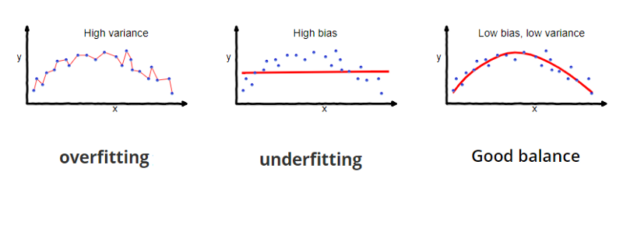

Slide 9
Why is Bias Variance Tradeoff?
If our model is too simple and has very few parameters then it may have high bias and low variance.
On the other hand if our model has large number of parameters then it’s going to have high variance and low bias.
So we need to find the right/good balance without overfitting and underfitting the data.
This tradeoff in complexity is why there is a tradeoff between bias and variance. An algorithm can’t be more complex and less complex at the same time.

Slide 10
Generalization in Machine Learning
Generalization refers to how well the concepts learned by a machine learning model
apply to specific examples not seen by the model when it was learning.
The goal of a good machine learning model is to generalize well from the training
data to any data from the problem domain. This allows us to make predictions in
the future on data the model has never seen.
There is a terminology used in machine learning when we talk about how well a
machine learning model learns and generalizes to new data, namely overfitting and
underfitting.
Overfitting and underfitting are the two biggest causes for poor performance of
machine learning algorithms.

Slide 11
Overfitting in Machine Learning
Overfitting refers to a model that models the training data too well.
Overfitting happens when a model learns the detail and noise in the training data to the extent that it negatively impacts the performance of the model on new data.
This means that the noise or random fluctuations in the training data is picked up and learned as concepts by the model.
The problem is that these concepts do not apply to new data and negatively impact the models ability to generalize
Overfitting is more likely with nonparametric and nonlinear models that have more flexibility when learning a target function. As such, many nonparametric machine learning algorithms also include parameters or techniques to limit and constrain how much detail the model learns

Slide 12
Avoiding Overfitting
There are several methods to avoid overfitting:
Increase size of your training and test data.
Reduce number of variables, degrees of freedom and parameters of your model.
This will ensure your model is simple and will end up reducing noise (stochastic
behaviour) in the training data.
3. Use cross validation technique. It compares average of the generalization error of the
model with the previous average. Cross validation technique includes k-folds.
Penalize model parameters if they’re likely to cause overfitting. This process is
known as regularization.

Slide 13
Cross Validation
The most popular resampling technique is k-fold cross validation. It allows you to train and test your model k-times on different subsets of training data and build up an estimate of the performance of a machine learning model on unseen data.
A validation dataset is simply a subset of your training data that you hold back from your machine learning algorithms until the very end of your project. After you have selected and tuned your machine learning algorithms on your training dataset you can evaluate the learned models on the validation dataset to get a final objective idea of how the models might perform on unseen data.
Using cross validation is a gold standard in applied machine learning for estimating model accuracy on unseen data. If you have the data, using a validation dataset is also an excellent practice.

Slide 14
What does regularization mean?
Regularization can be used to solve overfitting problems. Regularization means explicitly restricting models to avoid overfitting.
In the context of machine learning, regularization is the process which regularizes or shrinks the coefficients towards zero.
In a simple sentence, regularization discourages learning a more complex or flexible model, to prevent overfitting. It does fitting a function appropriately on the given training set and avoids overfitting.
There are two types of Regularization:
Lasso Regularization or L1 Regularization
Ridge Regularization or L2 Regularization
Regularization in Regression would be = Cost function + Penalty Term

Slide 15
What does regularization mean?
One of the ways to reduce overfitting is by regularization. Extra terms can be introduced in the model to penalise overfitting. LASSO (L1) and Ridge (L2) are well-known regularization techniques. L1 and L2 are two loss function that penalize by the size / square of the size of coefficients.
L1 minimises sum of the absolute differences between estimated and actual values.
L2 minimises sum of the squared differences between estimated and actual values.
L1 is robust but L2 is considered stable.

Slide 16
Machine Learning Steps
Data collection: Start with training data for which we know the correct outcome provided by a “teacher”
Representation: Decide how to encode the input to the learning program
Modeling: Choose a hypothesis class – a set of possible explanations for the data
Estimation: Find best hypothesis you can in the chosen class
Model selection: We may reconsider the class of hypotheses given the outcome

Slide 17
Learning and Probability
There are many sources of uncertainty with which learning algorithms must cope:
  Variability of the data
  Dataset collection
  Measurement noise
  Labeling errors
Probability and statistics provide an appropriate framework to deal with uncertainty
Some basic statistical assumptions:
  Training data is sampled from the “true” underlying data distribution
  Future test data will be sampled from the same distribution

Slide 18
Features
Often, the individual observations are analyzed
into a set of quantifiable properties which are
called features. May be
– categorical (e.g. "A", "B", "AB" or "O", for blood type)
– ordinal (e.g. "large", "medium" or "small")
– integer-valued (e.g. the number of words in a text)
– real-valued (e.g. height)

Slide 19
Hypothesis Space
One way to think about a supervised learning machine is as a device that explores a
“hypothesis space”.
– Each setting of the parameters in the machine is a different hypothesis about the function that maps input vectors to output vectors.

Slide 20
Generalization
The ultimate goal is to do as well as possible on new, unseen data (a test set), but we only have access to labels (“ground truth”) for the training set
What makes generalization possible?
Inductive bias: set of assumptions a learner uses to predict the target value for previously unseen inputs
  This is the same as modeling or choosing a target hypothesis class
Types of inductive bias
  Occam’s razor
  Similarity/continuity bias: similar inputs should have similar outputs

Slide 21
The aim is to get the network to generalize to classify new inputs appropriately.
If the training data is known to contain noise, we don’t necessarily want the training data to be classified totally accurately, because that is likely to reduce the generalization ability

Slide 22
Achieving good generalization
Consideration 1: Bias
  How well does your model fit the observed data?
  It may be a good idea to accept some fitting error, because it may be due to noise or other “accidental” characteristics of one particular training set
Consideration 2: Variance
  How robust is the model to the selection of a particular training set?
  To put it differently, if we learn models on two different training sets, how consistent will the models be?

Slide 23
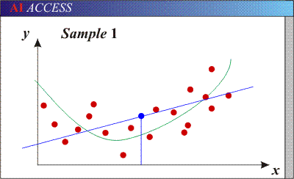
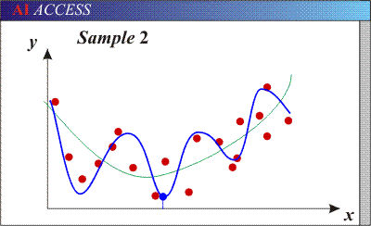
Bias/variance tradeoff
Models with too many parameters may fit the training data well (low bias), but are sensitive to choice of training set (high variance)
Generalization error is due to overfitting
Models with too few parameters may not fit the data well (high bias) but are consistent across different training sets (low variance)
Generalization error is due to underfitting
2

Slide 24
Underfitting and Overfitting
How to recognize underfitting?
  High training error and high test error
How to deal with underfitting?
  Find a more complex model
How to recognize overfitting?
  Low training error, but high test error
How to deal with overfitting?
  Get more training data
  Decrease the number of parameters in your model
  Regularization: penalize certain parts of the parameter space or introduce additional constraints to deal with a potentially ill-posed problem

Slide 25
The Bias/Variance Trade-off
If a network is to generalize well to new data, it obviously needs to generate a good approximation to the underlying function g ( xi ) =E[ y | xi ], and to do that it must minimise the sum of the bias and variance contributions to the generalization error. There will be a trade-off between minimising the bias and minimising the variance.
Networks which are too closely fitted to the data will tend to have a large variance and hence give rise to a large expected generalization error. Consequently, we then say that over-fitting of the training data has occurred.
We can easily decrease the variance by smoothing the network outputs, but if this is taken too far, then the bias becomes large, and the expected generalization error is large again. We then say that under-fitting of the training data has occurred.
This trade-off between bias and variance plays a crucial role in the application of Machine Learning techniques to practical applications.

